Slide 1
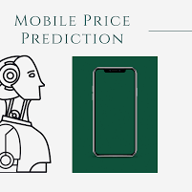
MOBILE DATA ANALYSIS TO PRIDICT THE MOBILE PRICE ON FEATURE BASIS

Slide 2
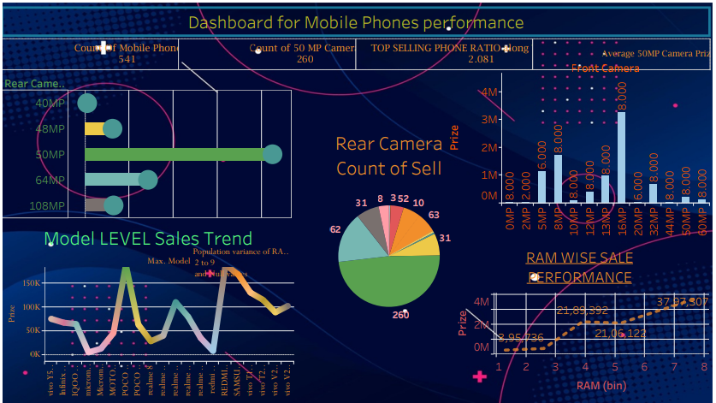
Mobile sales dashboard on the feature basis which feature does performance well .
50 MP rear camera mobile phone did sell well with 260 mobile set sale out of 541 over all mobile sale.

Slide 3
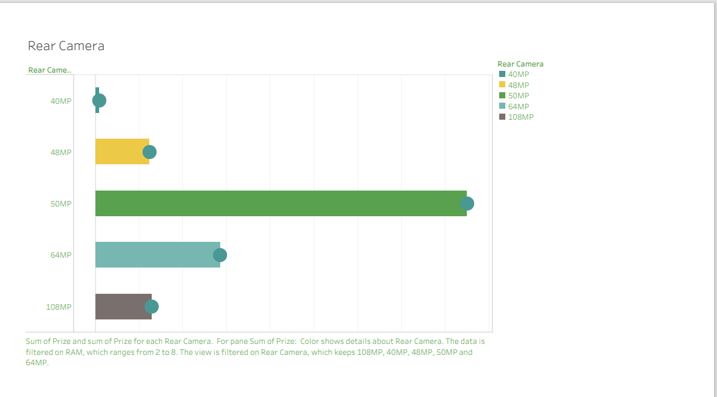
Feature performance : Rear Camera

Slide 4
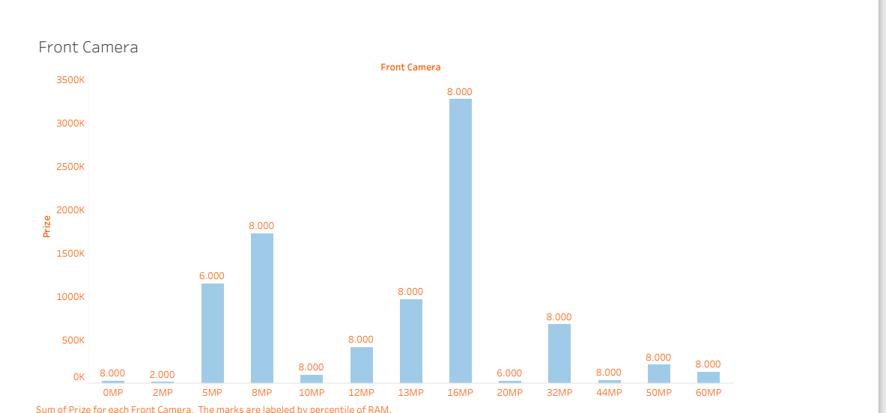
Feature performance : Front Camera

Slide 5
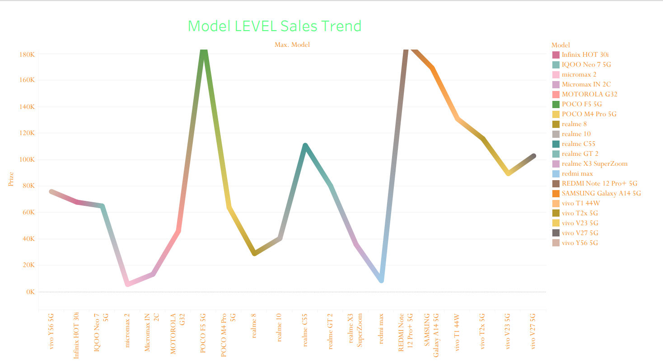
Feature performance : Front Camera

Slide 6
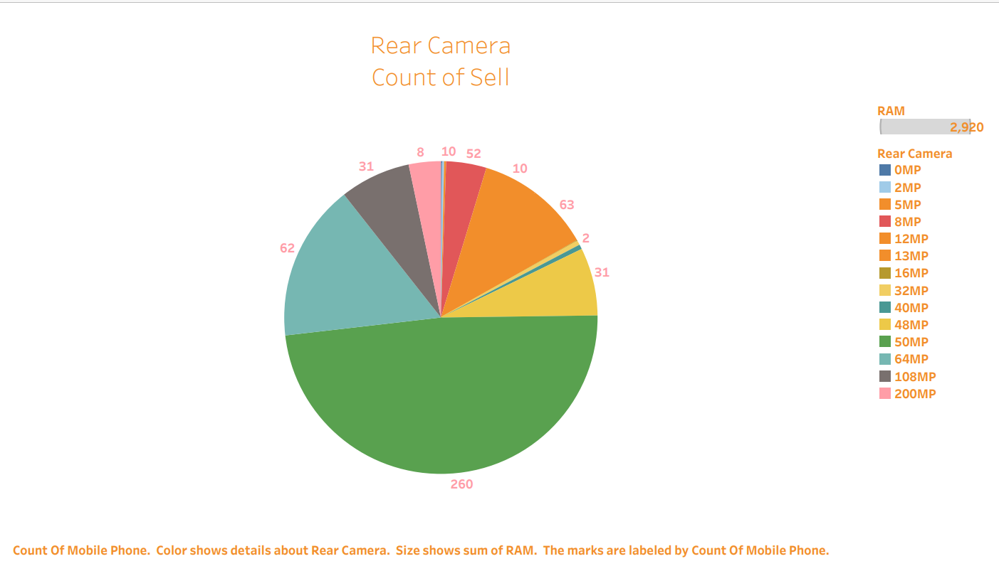
Pie plot on the Rear Camera

Slide 7

Mobile Price Prediction

Slide 8
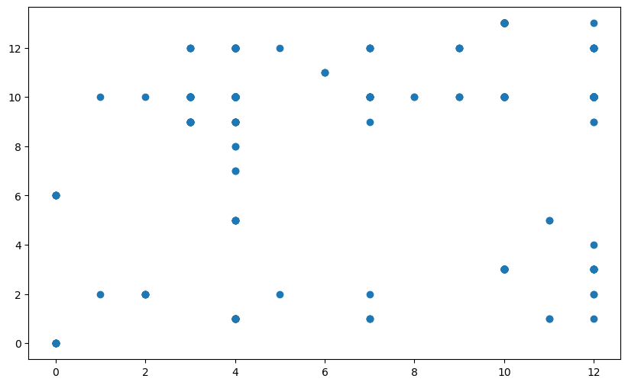
Correlation Rear Camera & Front Camera

Slide 9
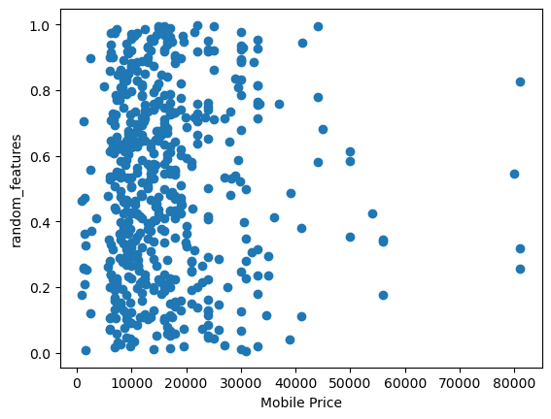
Sactter plot on the rendom feature & mobile price
Between price 4000 to 20000 correlation with random feature

Slide 10
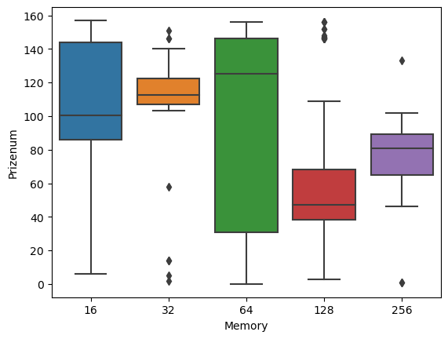
OUTLIER BETWEEN PRICE & MEMORY
64 GB memory camera highly correlated & 0 to 25 price range is out lier in all the type of memory

Slide 11
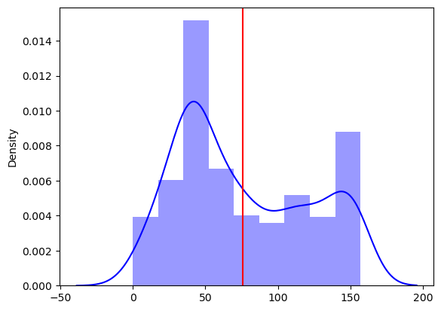
Find the Mobile price density

Slide 12
Correlation table
 | Memory | RAM | Battery_ | Prize | RearCameranum | Modelnum | FrontCameranum | Processor_num
Memory | 1 | 0.63 | -0.05 | 0.57 | -0.02 | 0.04 | -0.38 | -0.15
RAM | 0.63 | 1 | -0.1 | 0.53 | -0.02 | 0.01 | -0.44 | -0.11
Battery_ | -0.05 | -0.1 | 1 | -0.03 | 0.26 | -0.09 | 0.41 | -0.14
Prize | 0.57 | 0.53 | -0.03 | 1 | -0.02 | -0.08 | -0.33 | -0.05
RearCameranum | -0.02 | -0.02 | 0.26 | -0.02 | 1 | 0.05 | 0.11 | -0.03
Modelnum | 0.04 | 0.01 | -0.09 | -0.08 | 0.05 | 1 | -0.08 | 0.04
FrontCameranum | -0.38 | -0.44 | 0.41 | -0.33 | 0.11 | -0.08 | 1 | -0.12
Processor_num | -0.15 | -0.11 | -0.14 | -0.05 | -0.03 | 0.04 | -0.12 | 1

Slide 13
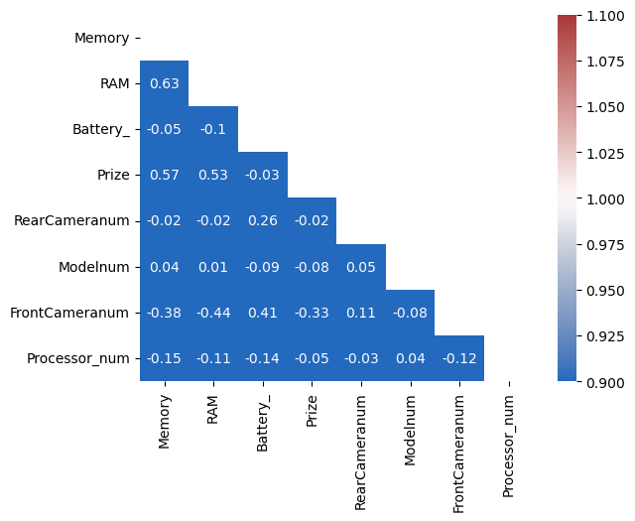
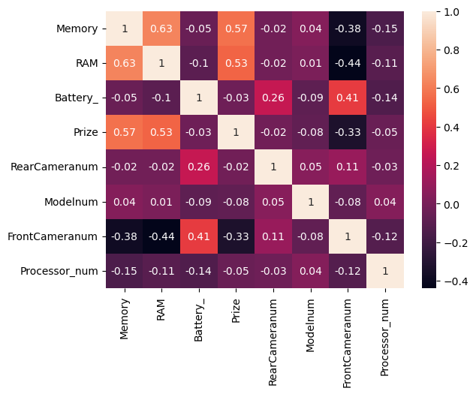
Het map on the to find the correlation between feature

Slide 14
Heat Map on Matrix
Top correlation 4 function with Memory & Ram where we go with this relation in future

Slide 15
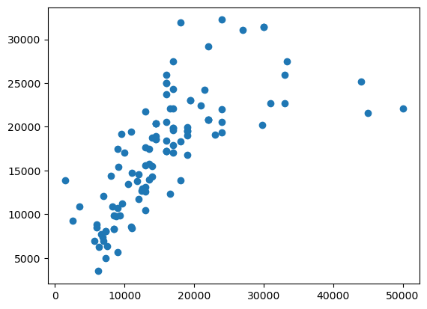
Scatter plot on the “Y” Prediction value

Slide 16

Observation & Way forward
Price Prediction :-
Final predict the price on the bases of feature which is related with the price point of the Mobile phones.
The predicted price of the Mobile phone on the Memory, RAM, Battery, AI tolls & both camera.
We have predicted Mobile phone price is 18573 on the above best feature which strongly correlate with price.
Tableau dashboard observation :-
The 50 MP camera mobile phone got sell well almost 259 mobile phone got sale out of 541 total sale.
Apart from that 16MP front camera most reliable feature of the mobile
8 GB RAM mobile phone mix is too high in compare of other size on RAM.

